Slide 1

JA COMPANY PROGRAM
PHASE 4: LAUNCH
WEEK 6-12 OR 6-15

Slide 2

WEEK 6-12 OR 6-15 AGENDA
PHASE 4: LAUNCH
ATTENDANCE & COMPANY MEETING (15 MIN)
CONDUCT BUSINESS OPERATIONS (AS REQUIRED)
MONITOR COMPANY SUCCESS (AS REQUIRED)
PLAN & CONDUCT INTERIM STATUS MEETING (AS REQUIRED)
ENTREPRENUERIAL RESILIENCY MODULES (10 MIN)
QUESTIONS & WRAP UP (5 MIN)
Notes:
See the appendix at the end of the presentation to find optional activities.

Slide 3


COMPANY MEETING
Notes:
Attendance (5 min)
VP HR and his/her team should now be responsible for taking weekly attendance.

Slide 4

Company Meeting
Attendance
President’s report
Report from each department, including:
Goals for the session/week
Challenges, successes, and updates
Open forum for members to:
Ask questions
Identify challenges and successes
Discuss issues that may have arisen from changes that may have to be made due to the Test of Disclosure.
Upcoming items:
Deadlines, sales opportunities, etc.
Notes:
Company Meeting (15 min)
Each session should begin with a short meeting that includes a report from each department.
Allow the team to conduct their weekly team meeting and take attendance.

Slide 5
BUSINESS OPERATIONS

Slide 6



Business Operations
ON-GOING IN PHASE 4
PRODUCTION
MARKETING INITIATIVES
SALES
Notes:
Conduct Business Operations (as required)
The Vice President of Marketing and the Vice President of Sales should review with the company members the company’s sales goals, conduct sales training, and provide ongoing support regarding the sales presentation.

Slide 7
MONITOR COMPANY SUCCESS

Slide 8
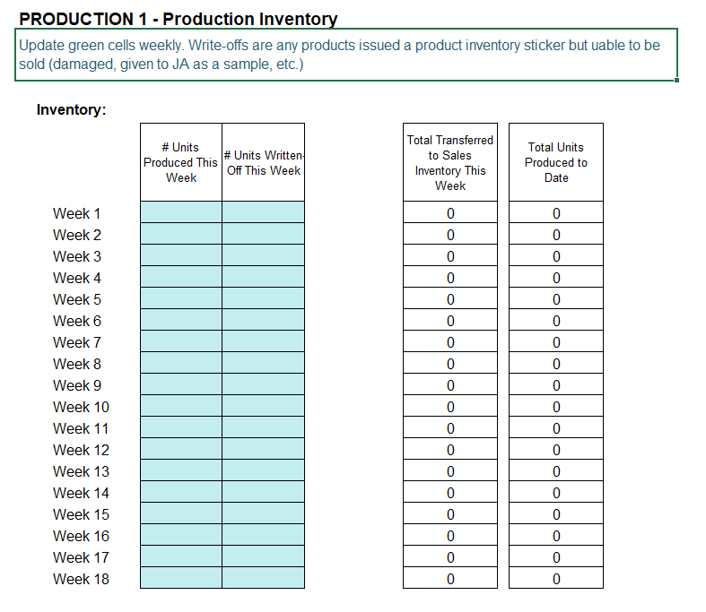

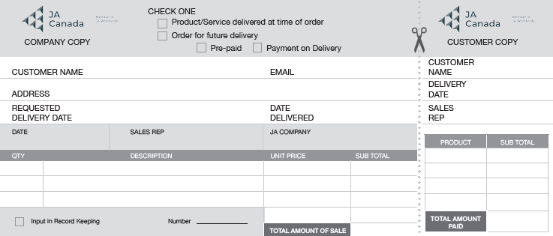
Monitor Company Success
HOW IS THE COMPANY DOING?
Key Activities:
Receive sales receipts
Manage inventory
Record keeping
Notes:
Monitor Company Success (as required)
Receive Sales Receipts and manage inventory. Explain it is critical that up-to-date, correct and transparent records are kept to maintain current financial figures.
Refer to the Sales Receipts PDF for copies.

Slide 9
INTERIM STATUS MEETING

Slide 10
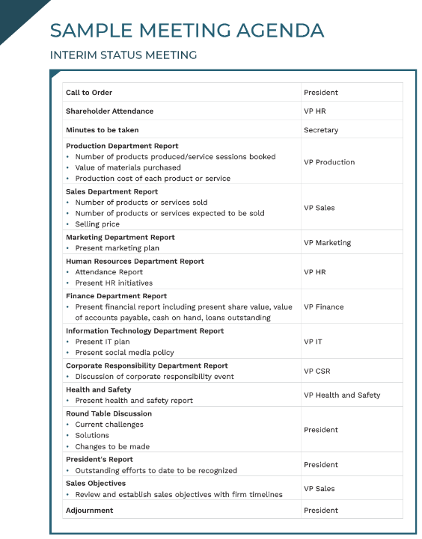
Interim Status Meeting
Use the Sample Meeting Agenda to prepare for the Interim Status Meeting.
The goal of this meeting is to:
Summarize the results
Compare to business planning
Notes:
Plan for and conduct an Interim Status Meeting (as required)
About halfway into operating the company (around week 10), a formal Interim Status Meeting should be scheduled to have the management team summarize the results and compare to plan.
Use the Sample Meeting Agenda - Interim Status Meeting template as a guide.

Slide 11
MANAGEMENT TEAM CHECK-IN

Slide 12

Management Team Check-in
Notes:
Management Team Check-in (as required)
During this Phase, Mentors are encouraged to conduct an informal management check-in between weeks 8-9.
The members of the management team will have been in their roles for a few weeks and completed planning; therefore, it is time to check in to see how they are feeling and if they are on task.
This meeting offers an opportunity to provide constructive feedback, acknowledge efforts and provide some coaching as needed.
Consider guiding the conversation with the discussion questions on the slide.
At the same time, conduct an informal check-in with members from each department to see how they are feeling and if they have concerns about the company’s direction.
If concerns or challenges arise during these check-ins, discuss them with your Program Manager to determine the best course of action.

Slide 13
ENTREPRENEURIAL RESILIENCY MODULES

Slide 14
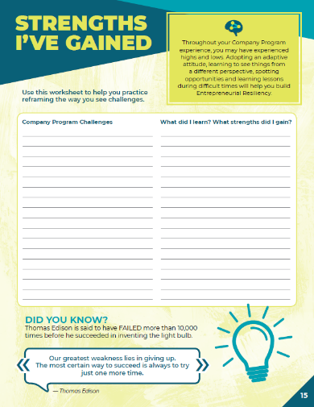
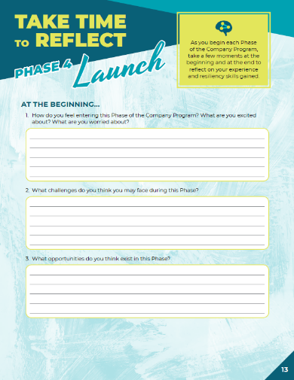

Company Program Resiliency Modules
Entrepreneurial resiliency is the ability to adapt to changes in your business and bounce back when things are challenging.
As you complete the JA Company Program, use this journal to reflect on your own resiliency and the skills you are gaining.
Notes:
Company Program Resiliency Modules (10 min)
Using the Company Program Resiliency Modules advisor guide, follow the instructions to guide students through the activities and discussions for Phase 4.

Slide 15
QUESTIONS & WRAP UP

Slide 16



Questions & Next Steps
QUESTIONS?
NEXT STEPS
Ongoing business operations
Begin planning for concluding the business and celebration
Notes:
Wrap-Up (5 min)
At the end of each week, provide students the opportunity to ask any questions or provide feedback on how they are feeling to date.
Review the next steps with students:
Near the end of phase 4, begin planning for concluding the business and celebration.
Advisors:
Gather attendance records and any outstanding forms to share with the local JA Charter office.
Address any questions, concerns or feedback to your Company Program Manager.

Slide 17
JA COMPANY PROGRAM
OPTIONAL ACTIVITES
PHASE 4

Slide 18
DELEGATION

Slide 19


Delegation
Do you grow all your own seed, fruits and vegetables? Raise your own beef, chicken and pork?
OR do you delegate?
Do you grow your own cotton, weave your own fabric, and make your own clothes?
OR do you delegate?
Notes:
Delegation (30 min)
To bring the simplicity of delegation to the forefront, ask these two questions and who these tasks are typically delegated to.
Despite the fact that you may be able to do it better yourself, do you actually grow all your own seed, fruits and vegetables and raise your own beef, chicken and pork? Or do you delegate everything related to that responsibility to your grocer?
Instead of growing your own cotton, weaving your own fabric, and making your own clothes, don't you delegate every aspect of that responsibility to merchants who provide you with excellent results in a timely manner for a reasonable fee?

Slide 20

Delegation
DELEGATION IS A MINDSET
Identify key opportunities for delegation
Communicate the task
Play to your team’s strengths
Construct a timeline
Entrust and empower
Follow up
Create a feedback loop
Notes:
Delegation (30 min)
Delegation is a mindset.
It might be intimidating to some to think of telling others what to do, but there are some strategies to help:
Identify key opportunities for delegation. Not everything can or should be delegated.
Communicate the task. Describe to the employees exactly what you want done, when you want it done, and the end results you expect. Do you feel that all Company members are abiding by the Code of Ethics and applying the Test of Disclosure when needed?
Play to your team’s strengths. Even within your department, each member of your team will have unique skillsets, preferences, and talents. Making good use of those unique working personalities will result in greater efficiency.
Construct a timeline. Timelines will help keep your team focused and accountable. Work with your team to establish a mutually agreed-upon timeline from the beginning of the task's delegation to its delivery.
Entrust and Empower. Entrust is a keyword in delegating. It means that you care about the results of what you delegate and you're willing to provide the support needed to help the employee achieve results. But you're going to let the employee do the assigned job. You don't have to be hands-on for the right outcomes to occur, but neither are you uninvolved and unaware of what's occurring.
Follow up. Following up occasionally, especially for long-term tasks, gives you insight into progress and gives the employee the opportunity to bring up any questions or obstacles that have arisen. Set reminders for yourself to follow up and ensure the task's timely completion.
Create a feedback loop. After delegating your tasks, follow up with your co-workers to learn from the situation. Ask them if they were comfortable executing the task and if you've given them all the information they needed. Ask how effective you were in setting expectations and if your timelines were reasonable.﻿
Encourage students as they continue to work on Company activities to review the task lists they created a few weeks back and ensure there is a name beside each task and that everyone has an equal distribution of work to complete.

Slide 21
CHANGE MANAGEMENT

Slide 22

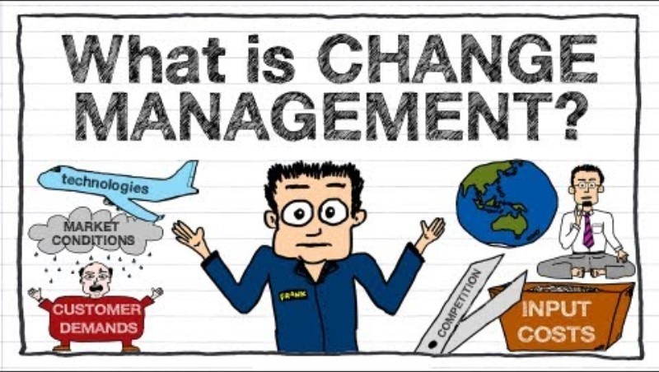
What is Change Management?
What is CHANGE MANAGEMENT? Training Video
Notes:
Change Management (30 min)
It is important to introduce the concept of change management, since despite the student’s best planning efforts, they may need to make adjustments to the way they operate.
These adjustments are a normal part of doing business.
Storming is a normal part of developing a team. Reviewing the 5 stages of Team Development and identifying where their team is at is a good check in.
Watch the video to introduce the concept:

Slide 23

Change Management
Change management is the process, tools and techniques to manage the people side of change.
It incorporates a way to help individuals make successful transitions through change.
Notes:
Change Management (30 min)
Define change management
Explain that individuals will respond to change differently. Some people may be more adaptable than others.
Implementing a change may not be comfortable for everyone, or even the individual suggesting the change, since we can never be 100% sure it is the right decision.
In an effort to be adaptable and flexible to change, especially in today’s environment, one must be “okay” with achieving 80% completion vs. 100% perfection.

Slide 24


Agile
The idea of being agile to accepting new ways of doing things, changing direction, and being okay with failure, will allow us to get to a greater place as a result of openness to change.
Being agile emphasizes:
Adaptability
Collaboration
Openness to feedback
Iteration
Notes:
Change Management (30 min)
Remind students that they are not alone when needing to discuss challenges to problem-solve solutions.

Slide 25

Change Management Activity
CHOOSE AN ACTIVITY
Cross Your Arms
Alien for Dinner
Change Places
P-P-P-P Exercise
Bouncing Back from Adversity
Can Do Company
Notes:
Change Management (30 min)
Complete one or more of the Change Management Activities PDF.
The activities are designed to engage with resistance in a meaningful way, question why students may fear change and create a more positive attitude towards new things.

